Slide 1
Wave structure identification in neural columns
Vincent Baker
Drexel University Department of Physics

Slide 2
Wave Structures
Previous work has demonstrated the existence of both traveling and standing wave structures in various areas of the brain
Previous simulation efforts have studied traveling waves in a 2-D planar neural networks with local connectivity
We observe traveling waves in “1-D” neural columns with local connectivity and random stimulus
2-D phase diagram: reach and speed versus speed constant and connectivity constant
Go to four column ensemble
We are interested in characterizing these waves and understanding how the neural column topology and dynamics change the wave behavior
Do we observe traveling waves at all?
How dense are the waves?
“Flux”
Wave firings versus total firings
Wave “thickness” or “wave packet height” or sigma? Plot histogram of a time interval
How regular are the waves? Histogram of start times
How fast do the waves travel?
What happens when waves collide?
How does the column topology and neuron characteristics change the wave behavior?

Slide 3
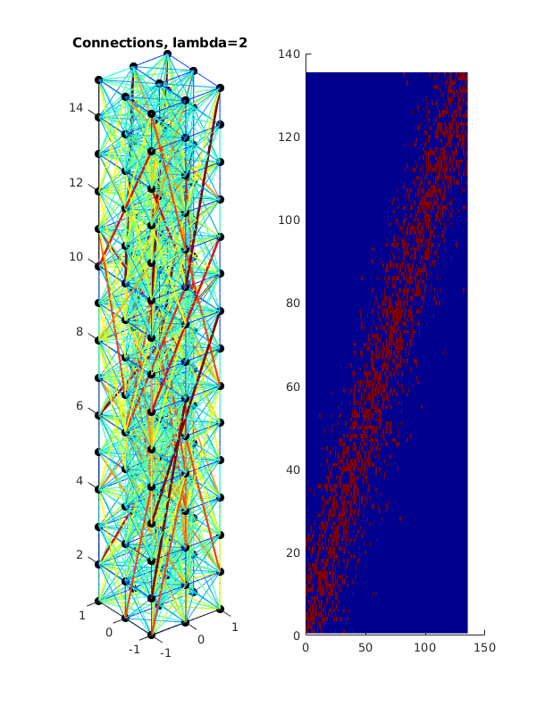
Column structure
Neurons on a unit spacing
Column topology defined by x-y cross section and z height, waves travel along z axis
Neurons are connected probabilistically using distance model with exponential decay, high local connectivity with sparse long-distance connectivity
Z axis
3x3x15 column

Slide 4
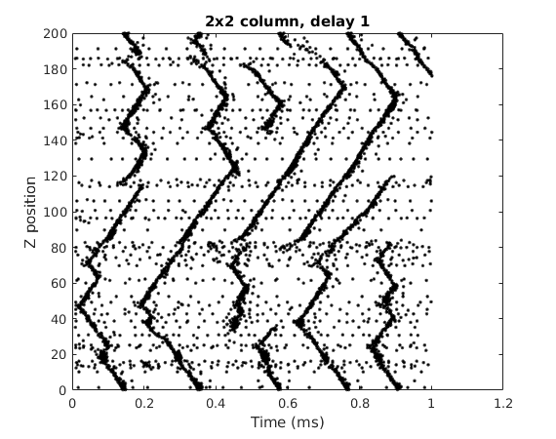
Example waves
We plot the neuron firings over time, with one black mark per firing event
We plot each neuron firing at the Z position of the neuron. There are multiple neurons at each Z position so there can be overlapping marks
Wave collision and annihilation
Background firing activity defined as firing events that are not part of a wave structure
Traveling wave initiation
Is wave regularity set by specific groups of neurons?
Run same column with different stimulus.
Question: Is there a group of neurons that fire regularly?

Slide 5
Wave identification
Need an automated process to ID waves so we can characterize them
What defines a traveling wave? A region of high firing density that propagates in the Z direction
ID approach:
Identify regions of high firing density with a filter-and-threshold operation, each region has a time and Z coordinate
Search through time until we find the first high density region. Mark it as the start of a new wave.
As we find new high density regions, test to see if they are part of any of the existing waves. If so, add that region to the existing wave. If not, start a new wave.
Continue through the end of the simulation time.

Slide 6
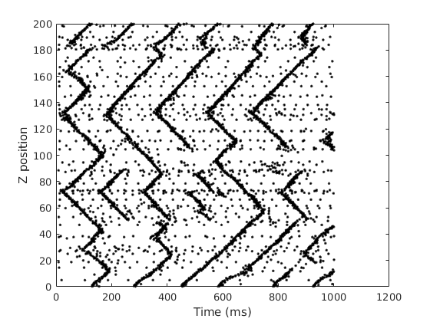
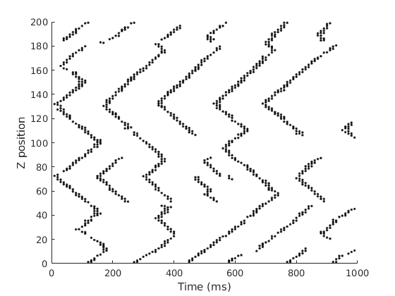
Wave ID example
Firing events
High density regions
Filter

Slide 7
Wave ID example
Time 0
Time 40
Time 100
Two new waves ID’d
High density regions associated to first two waves
Two new waves identified
Wave IDs continue to extend

Slide 8
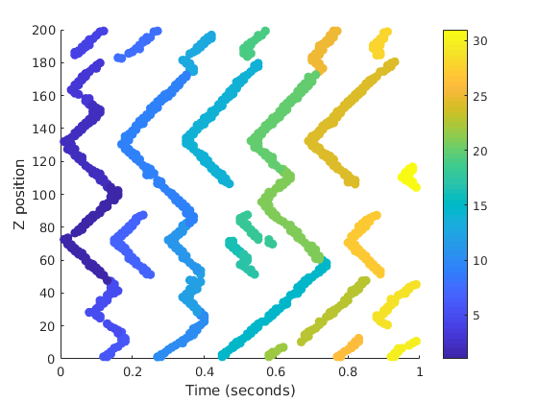
Wave ID results
Firing events
High density regions
Waves
Filter
ID
Output: collection of wave structures. Each wave structure is a set of {time, height} points.
Test with bottom stimulus.

Slide 9
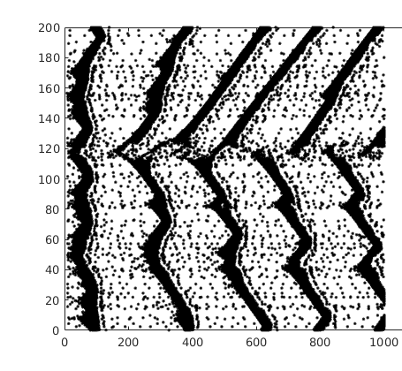
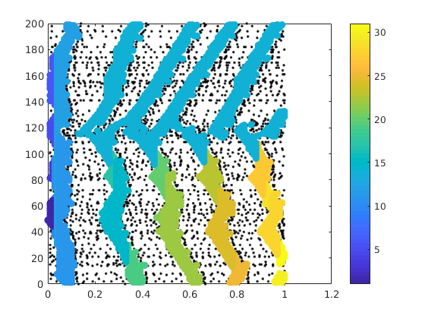
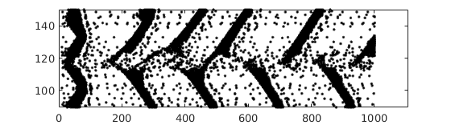
2x2 versus 3x3 column
2x2 firings
2x2 waves
3x3 firings
3x3 waves
Zoom below
In both 2x2 and 3x3 columns many waves seem to spawn from same Z coordinate (orange dashed lines). This behavior is consistent, but the specific Z positions vary between simulations. The thicker lines in the 3x3 column create issues in the wave identification – the zoomed region below spawns 5 waves but they all end up labeled as a single wave.
WAVE ECHO?
Detail of the region in the 3x3 column

